Slide 1
We're expected to
01
grasp the expressions showing feelings;
02
learn about what Han Jing experiences and her feelings on the first senior high school day;
03
talk about our first senior high school day.

Slide 2
Welcome Unit Reading

Slide 3
✿How did you feel on your first day of senior high school? Why?
I felt ... because/for the reason that...
Expressions showing feelings
happy/
excited
comfortable/
relaxed
anxious/worried
amazed
frightened
angry/
annoyed
awkward/
embarrassed （尴尬的）

Slide 4
When facing a brand-new start, one can have mixed feelings. So does Han Jing, a senior high school freshman.

Slide 5
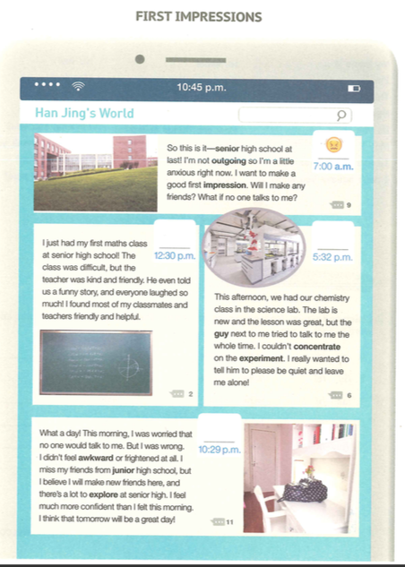
Before reading
✿Where do you think the text is taken from? How do you know?
----It is a text taken from a social
networking website.
comments

Slide 6
Read the text and finish the table.
First impressions
Time | Place/Occasion(场合) | Feeling
7:00 a.m.
the campus
12:30 p.m.
the maths class
5:32 p.m.
the chemistry class
10:29 p.m.
the dormitory/ home

Slide 7
Pair Work
Try to infer her feelings based on the experiences.
Time | Place/Occasion | Feeling
?
7:00 a.m.
the campus
a little anxious
12:30 p.m.
the maths class
5:32 p.m.
the chemistry class
10:29 p.m.
the dormitory/ home
Han Jing was not an _______ girl. She wondered whether she would ____________________________________ and what she should do if ________________.
outgoing
make a good impression
no one talked to her

Slide 8
Time | Place/Occasion | Feeling
7:00 a.m.
the campus
a little anxious
12:30 p.m.
the maths class
happy
5:32 p.m.
the chemistry class
10:29 p.m.
the dormitory/ home
The maths class was difficult, but the funny story told by her kind and friendly teacher made them laugh so much. And she found most classmates and teachers
friendly and helpful.
&& find sb/sth. + adj. ….

Slide 9
Time | Place/Occasion | Feeling
7:00 a.m.
the campus
a little anxious
12:30 p.m.
the maths class
happy
5:32 p.m.
the chemistry class
annoyed
10:29 p.m.
the dormitory/ home
The guy next to her tried to talk to her all the time, which made her
unable to concentrate on the experiement.
Think: If you were in her situation, what would you do?
---- tell him to be quiet and leave you alone.
( not disturb you)

Slide 10
Time | Place/Occasion | Feeling
a little anxious/ frightened
7:00 a.m.
the campus
12:30 p.m.
the maths class
happy
5:32 p.m.
the chemistry class
annoyed
confident+ happy+excited
10:29 p.m.
the dormitory/ home
After experiencing the day, she believed that ….
she would make new friends and that there was a lot to explore, expecting the next day would be a great day!

Slide 11
What did Han Jing learn from her first day at senior high shcool?
Pair Work
She learned that there was no need to feel anxious, awkward or frightened.
She learned that she would make new friends there.
She learned that there would be a lot to explore at senior high.
She learned that tomorrow would be a great day.
Thinking: What have you learned from her story?
Starting a brand-new life can be challenging at first, but it can also be….
interesting, exciting, amazing and even rewarding and unforgettable.
So,
be brave to take up the challenge and welcome the new school life!

Slide 12
Post reading
There is no need to be anxious!
You’ll be able to adapt to the new environment!
comments
Senior high school life is colorful, amazing and unforgettable!
Can you guess what the comments are?
Be brave to take up the challenge and welcome the new life.

Slide 13
Talk about your own first day of senior high school .
1How did you feel that day? Why ?
2 What impression did your classmates leave on you?
3 Which lesson impressed you most, and why?
4 What did you learn from your first day at senior high school?

Slide 14
New words and phrases:
outgoing adj.
Confident adj. Confidence n.
make a good impression on sb
anxious adj.
be anxious about….
What if….?
I found sb./sth. + adj.
leave me alone
feel awkward or frightened
There is a lot to explore. v.
Challenging adj.
Rewarding adj.
take up the challenge and welcome the new school life

Slide 15
Assignment
1. Please write a passage about 80—100 words to introduce your first senior high school day.
2. Finish the “Word Study” part on Page 5.

Slide 16

Thanks！

